Slide 1
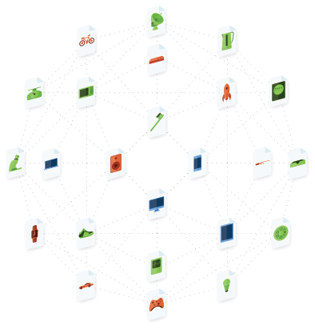
IoT, Fog Computing
and the Blockchain

Slide 2
About Me (in NZ)
Organisation | What I Learnt
Telecom NZ | Online self-service, sales
State Services Commission | Identity, privacy, Government
Internet NZ | Policy, standards, community building
Mega | Crypto, global-scale ops
Internet Party | Timing, people, politics
Swerl | ?

Slide 3
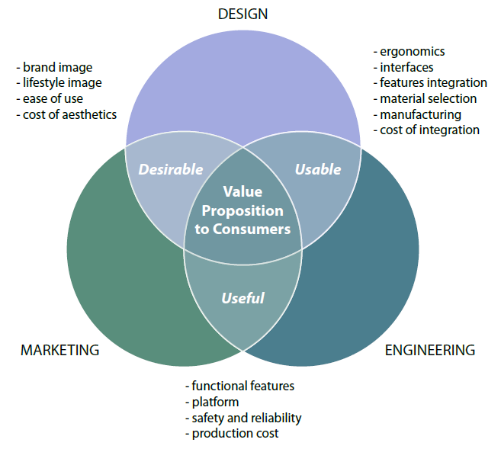
Breakthrough Products

Slide 4
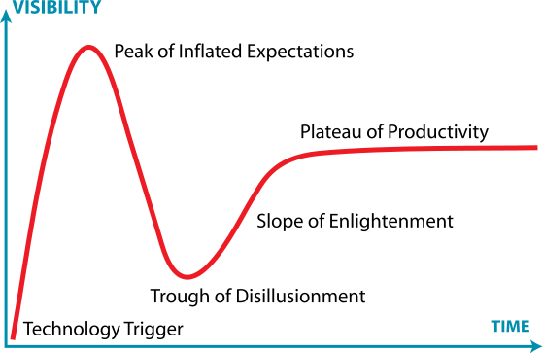
Every breakthrough technology is
over-estimated in the short-term
but under-estimated in the long-term

Slide 5
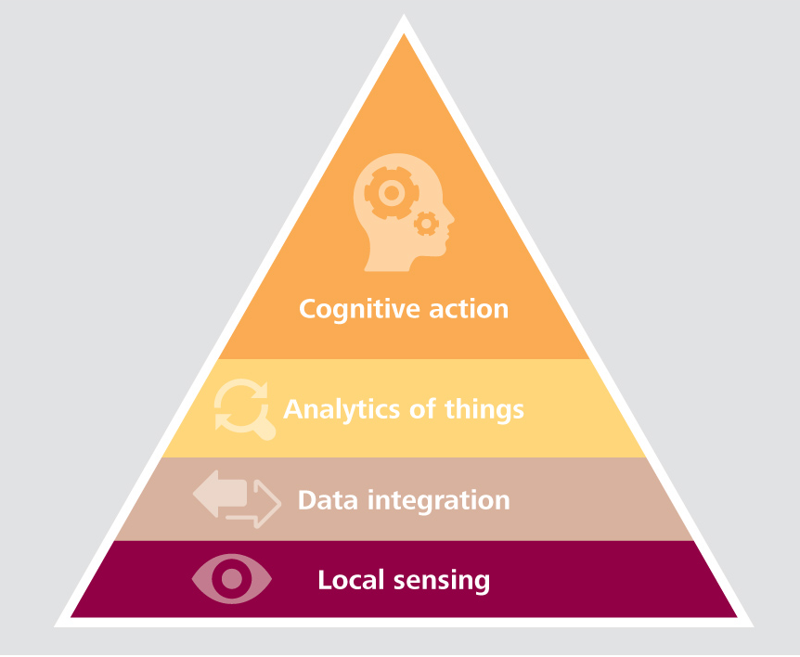
What is the IoT?
Data
Connectivity
Software
Hardware

Slide 6
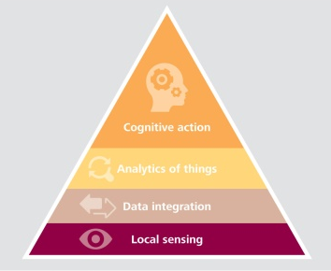
Silos Miss the Bigger Picture
New services, new value chains, new markets

Slide 7
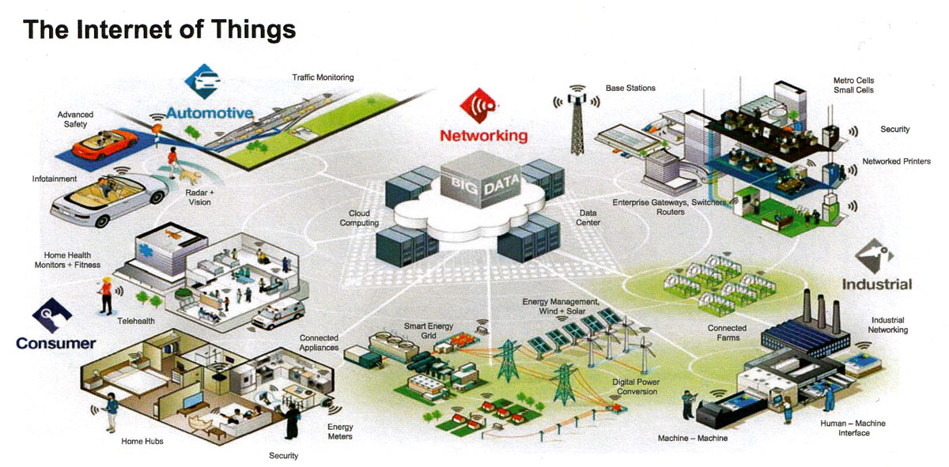
Not Just Consumer/DIY

Slide 8
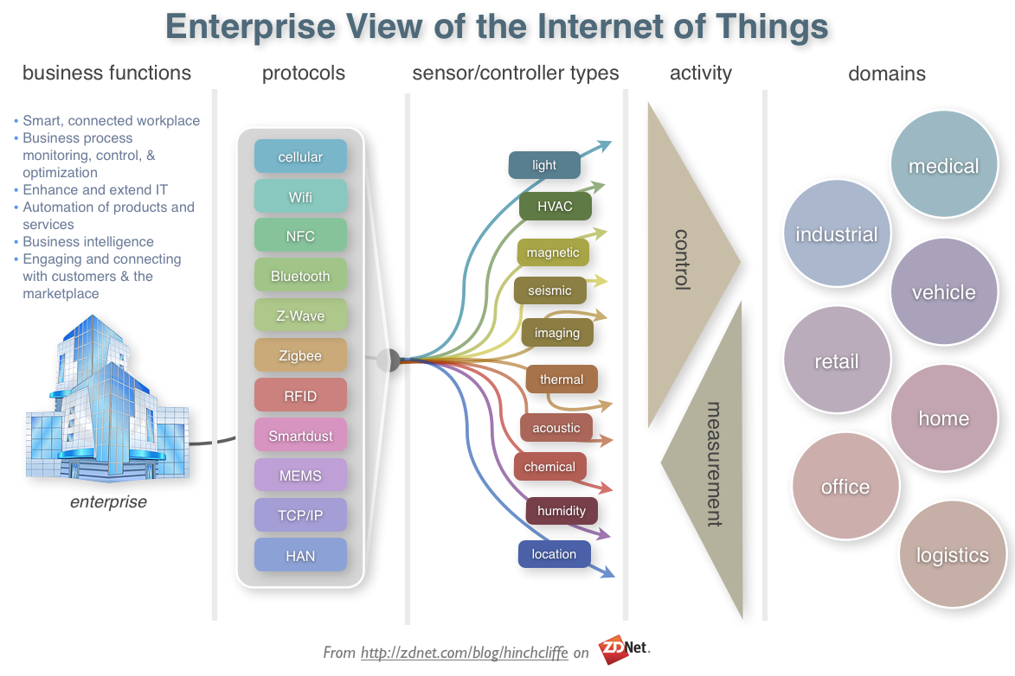

Slide 9
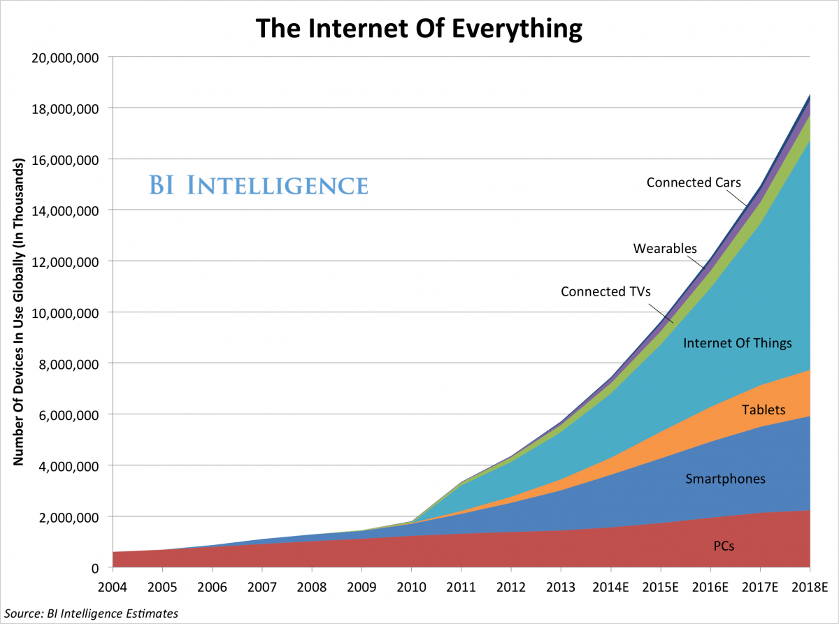
The Connectivity Explosion is Happening Now

Slide 10
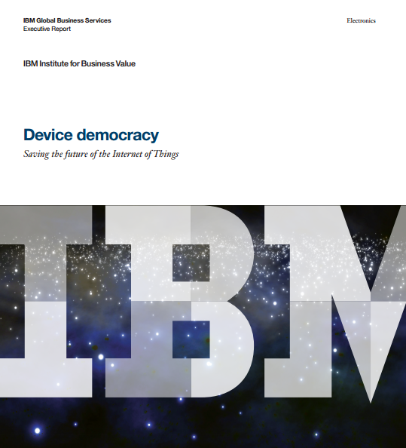
But There Are Problems
The cost of connectivity
Lack of trust
Not future-proof
Lack of functional value
Broken business models

Slide 11
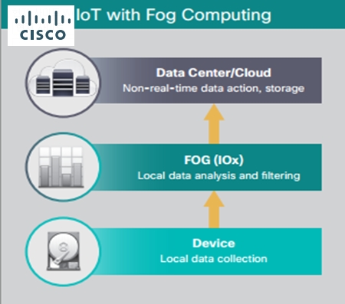
Cisco’s Fog Computing

Slide 12

So, what are we doing?

Slide 13
Building a Web of Things platform
on
a new internet

Slide 14
An Open Web of Things
New services, new value chains, new markets
Device identity, trust
Messaging
Collaboration, orchestration
Security
Device management
Micro-services

Slide 15
OK, but why do we need a new internet?
What’s wrong with the one we already have?

Slide 16

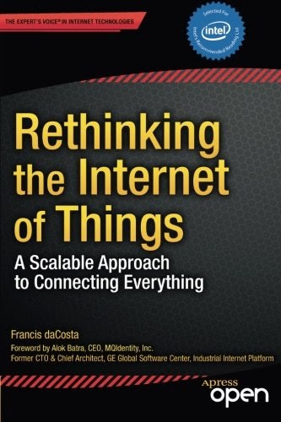
Because, Ants…
Individual simplicity
Collective sophistication

Slide 17
But, but…
How do you even build a new internet?

Slide 18
First, Get the Requirements Right for Permission-less Innovation
Open
Royalty-free
Decentralised
Scalable
Secure
Easy to deploy globally, and
Formally specified

Slide 19
Then, the Building Blocks
Service Centric and Information Centric Networking
A publish/subscribe architecture and dataflow/event processing network realised within RINA (Recursive InterNetwork Architecture)
Naming and addressing in the network, including a suitable domain name topology
Application layer inter-networking
The blockchain for state, replicated data-types, and authenticated links

Slide 20
The Blockchain
Probably Bitcoin’s major innovation
Foundation for new decentralised and distributed systems
The block chain is a technology step-change
to build a secure, scalable and open
coordination platform globally.
Not limited to currency or financial systems.

Slide 21
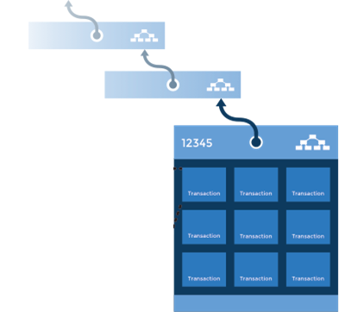
The Block Chain is
A ledger: an ordered record of transactions
verified
immutable
public
anyone can replicate and verify it independently
records consensus of the “truth”

Slide 22
Summary
We have a grandiose vision to build
A platform for an open Web of Things
On a new (co-existing) internet
And then extend that new internet to other domains
But our biggest challenge is to do so while being a commercial success

Slide 23

Questions / comments
Vikram Kumar © 2015
Co-founder, Swerl IO Ltd.
Email: vikram@swerl.io
Twitter: @vikram_nz

Slide 24
Image Sources
Slide 3: Creating Breakthrough Products http://www.creatingbreakthroughproducts.com/
Slide 4: http://en.wikipedia.org/wiki/Hype_cycle#mediaviewer/File:Gartner_Hype_Cycle.svg
Slide 5: Deloitte http://dupress.com/articles/internet-of-things-wearable-technology/
Slide 7: http://www.theregister.co.uk/2014/06/23/hold_interthreat/
Slide 8: http://www.zdnet.com/article/is-the-internet-of-things-strategic-to-the-enterprise/
Slide 9: http://www.businessinsider.com/growth-in-the-internet-of-things-2013-10?IR=T
Slide 10: http://www-01.ibm.com/common/ssi/cgi-bin/ssialias?infotype=PM&subtype=XB&htmlfid=GBE03620USEN#loaded
Slide 11: http://www.veriday.com/lean-user-interface-design/ http://net-of-things.blogspot.co.nz/
Slide 12: http://itersnews.com/?p=88531

